Slide 1
Hecker (2005)
46 NAICS 2000 = HT Industries
Crosswalk
IPUMS Variable
IND1990
Consistent through time
IND1990
1997 NAICS
1980 (5%)
1997 NAICS
1990 (1%)
1997 NAICS
2000-2002 (1%)
(ACS)
2002 NAICS
2007 NAICS
2012 NAICS
2003-2013 (1%)
(ACS)

Slide 2
Hecker (2005)
46 NAICS 2000 = HT Industries
Crosswalk
IPUMS Variable
IND1990
Consistent through time
IND1990
1980 (5%)
1997 NAICS
1990 (1%)
1997 NAICS
2000 NAICS
INDNAICS
2000 (5%)
IPUMS
Table 1
1997 NAICS
INDNAICS
2001-2013 (1%)
(ACS)

Slide 3
Hecker (2005)
46 NAICS 2000 = HT Industries
Crosswalk
IPUMS Variable
IND1990
Consistent through time
IND1990
IND1990
1980 (5%)
IND1990
1990 (5%)
IND1990
2000 (5%)
IND1990
2001-2013 (1%)
(ACS)

Slide 4
Crosswalk for Census 2000
Hecker (2005)
46 NAICS 2002 =
HT-Industries
IPUMS-2000 Census (5%)
2002 NAICS
46
1997 NAICS
46*
INDNAIC ^{1/}
46*
IND1990
46*
Equivalence Table from CDC
We could had also used the concordance from Census Bureau but the table was nicer
Table 1
in IPUMS
STATA
Code
NOTES:
*NAICS codes are produced every 5 years and existed for 1997, 2002, 2007, 2012
*CDC: Center for Control Decease has a very nice table website….
*Table 1 ipums→https://usa.ipums.org/usa/volii/indcross.shtml (see next slide)
^{1/} the INDNAICS variable in IPUMS 2000 census (5%) was created using 1997 NAICS

Slide 5
Crosswalk for Census 1980
Hecker (2005)
46 NAICS 2000 =
HT-Industries
2002 NAICS
1997 NAICS
INDNAICS
2000
INDNAICS
2003
IND1990
+
Equivalence Table from IPUMS
1980
1990
2000
2005-2013

Slide 6
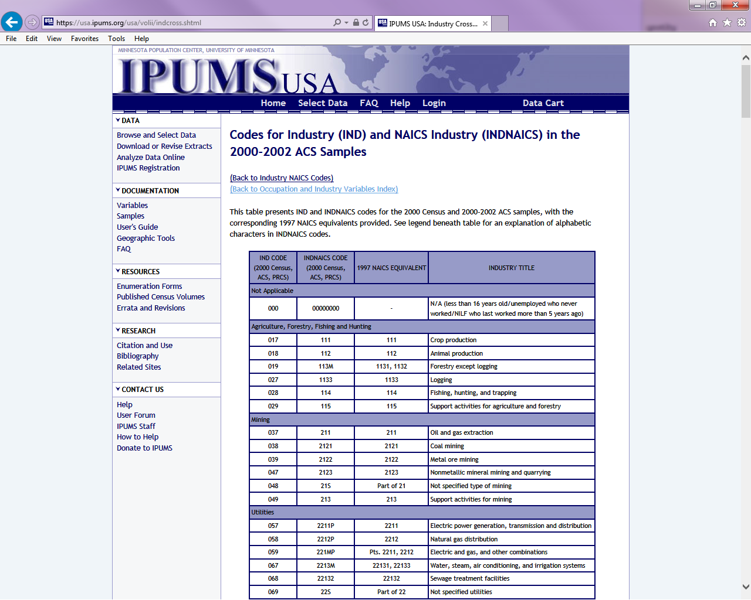
Table 1 https://usa.ipums.org/usa/volii/indcross.shtml

Slide 7
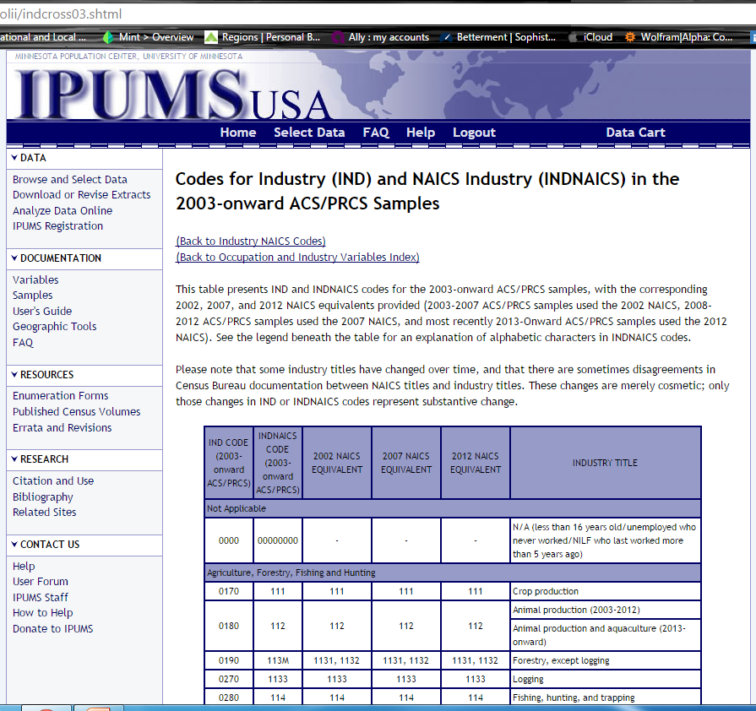
Table 2 https://usa.ipums.org/usa/volii/indcross03.shtml

Slide 8
Crosswalk between INDNAICS (2000) and IND1990 (in all samples)
Download 2000 (5%) census sample
Download Variables:
IND1990
INDNAICS2000
Keep only one respondent per INDNAICS2000 code
Drop all variables besides IND1990 and INDNAICS2000
You have transformed IND1990 into it’s INDNAICS2000 equivalent, you can use the labels from the crosswalk you linked to.
Crosswalk between INDNAICS and NAICS:
No direct translation since INDNAICS is an aggregation of NAICS codes
2000 INDNAICS→ 1997 NAICS (Table 1 from IPUMS)
2003 INDNAICS→2002/2007/2012) NAICS (Table 2 from IPUMS)

Slide 9
Crosswalk for NAICS 2002 to IND1990
Hecker (2005)
46 NAICS 2002 =
HT-Industries
IPUMS table 2
Ind1990_indnaics_crosswalk_ht_2005.do
Ind1990_indnaics_crosswalk
2002 NAICS
INDNAICS
2003 – on
IND1990
CDC NAICS
table
Ind1990_indnaics_crosswalk_ht.do
1997 NAICS
INDNAICS
2000-2002
IND1990
HT_crosswalk_csv
IPUMS table 1
Ind1990_indnaics_crosswalk_ht_2000.do
HT_crosswalk

